Slide 1
Completions Real Time Streaming Application
Friday November 30, 2017
Team Members
Anna Smith
Justin Cornell
Kendra Reeves
Kenah Nyanat
Rashaw Williams

Slide 2
Real Time Streaming Application – Overview
Completions Operations Problem Statement
Build a mobile or desktop application that can be used on field sites by Devon’s Person in Charge (PIC) to improve operational decisions or behaviors, during hydraulic fracturing by streaming real-time treatment data
Decisions and Behaviors to Influence
Better decisions on when to stop a stage
Better decisions on optimal pump rate to minimize cost
High Level Impact
Comparing current treating pressure to casing burst pressure
Monitoring net treating pressure (screenout leading indicator)
Predicting stage pump time remaining (cost savings measure)

Slide 3
Real Time Streaming Application – Solution / Benefits
Current
Future State
Ability to stream and visualize second by second real-time treatment data via desktop and mobile application
Apply KPI analytics “on-the-fly” at field sites, offices or anywhere
Allows user customization of dashboard
Scalable solution applied to multiple simultaneous treatment jobs
“Easy To Read” visuals
Real-time KPIs lookback with offset well treatment data (select well of choice for comparison)
Overlay offset treatment plot “on-the-fly” with current real time data to compare against successful “treatment signature”
Utilizing Machine Learning to score historical data to develop predictive screenout model
Ability to apply treatment changes “on-the-fly” to optimize well completion

Slide 4
Real Time Streaming Application – Data Architecture
Collection
Ingress
Stream Processing
Presentation
Alerting
Flow
Alerts
Mobile App
Pi
Azure Function
Event Hub
Azure Streaming Analytics
PowerBI
Blob
Azure Machine Learning
Desktop App
Historical data (scoring & training)

Slide 5
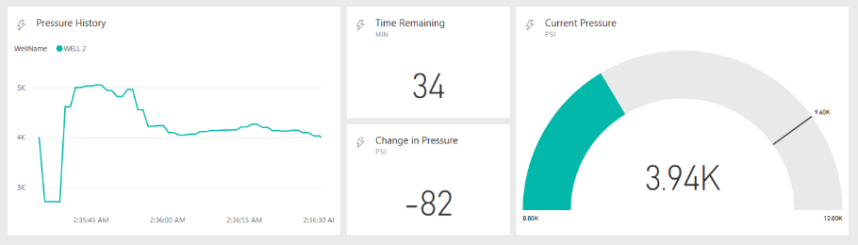
Dashboard Widget #1 – Current Treating Pressure KPI
Methodology
80% of max casing burst pressure (~10k psi)
Visual of pressure tolerances (median & max)
Business Impact
Visualization monitoring “critical” pressure value
Better decision for PIC to drop rate, flush well to prevent screenout (reduce friction pressure) or end stage
Future Enhancements
Develop pressure threshold bounds through machine learning predictions (historical offset datasets)

Slide 6
Dashboard Widget #2 – Net Treating Pressure KPI
Methodology
ΔP = P_{current} – P_{average}1
Business Impact
Leading indicator of potential screenout
Provide PIC with “easy to read” visualization of pressure trends
Future Enhancements
Expand to incorporate visual KPI for rate of change of ΔP to further support leading indicator
¹P_{average} = Rolling 10 Sec Average

Slide 7
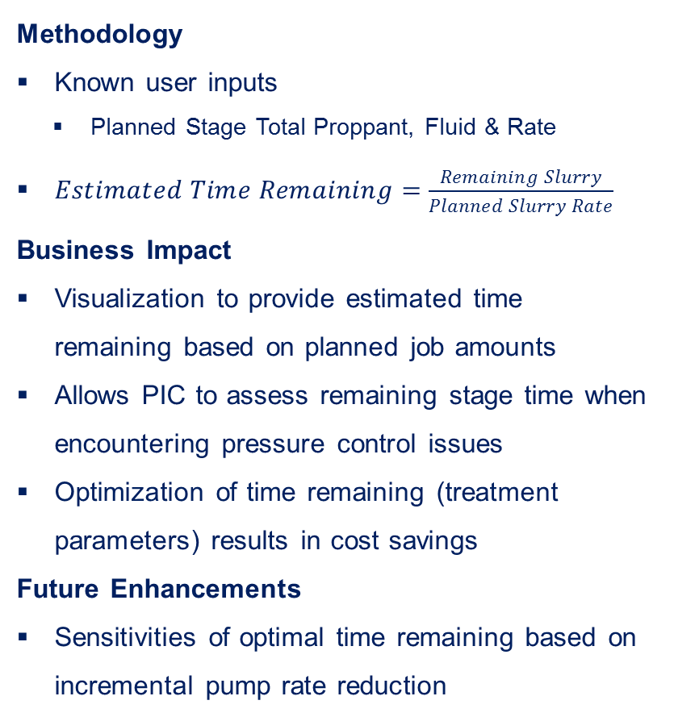
Dashboard Widget #3 – Estimated Stage Pump Time Remaining KPI
Methodology
Known user inputs
Planned Stage Total Proppant, Fluid & Rate
$Estimated Time Remaining=\frac{Remaining Slurry}{Planned Slurry Rate}$
Business Impact
Visualization to provide estimated time remaining based on planned job amounts
Allows PIC to assess remaining stage time when encountering pressure control issues
Optimization of time remaining (treatment parameters) results in cost savings
Future Enhancements
Sensitivities of optimal time remaining based on incremental pump rate reduction

Slide 8
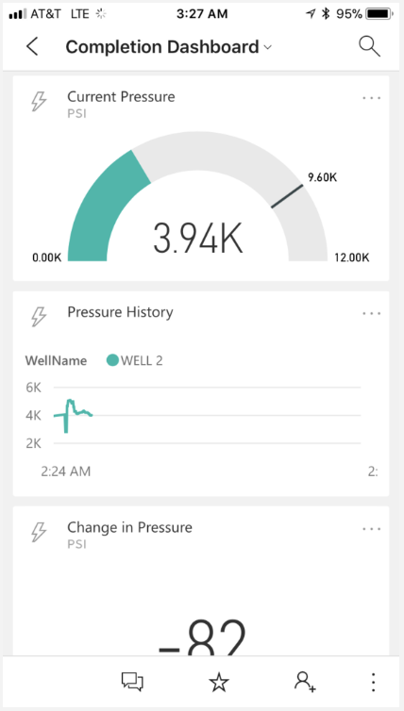
Field App for Fracturing Operations – Dashboard
Desktop
Mobile
https://vimeo.com/245341233

